Slide 1

Effect of linagliptin on AVI and API, indices of vascular stiffness evaluated by an automatic blood pressure monitor
the 9th Metabolic Syndrome, Type 2 Diabetes and Atherosclerosis Congress
Session: Poster 4 Session Theme: Atherosclerosis
Program No.: P25 Order in Session: 06
Time and Date: 13:10-14:10, Saturday, September 13
Venue: Annex Hall, Kyoto International Conference Center
Anna Sakashita, Reie Matoba, Yoshimi Abe, Chieko Morisawa,
Tomoko Morita, Yoshitaka Akiyama, Masafumi Matsuda.
Department of Endocrinology and Diabetes, Saitama Medical Center, Saitama Medical University, Saitama, JAPAN

Slide 2
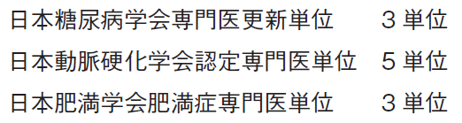
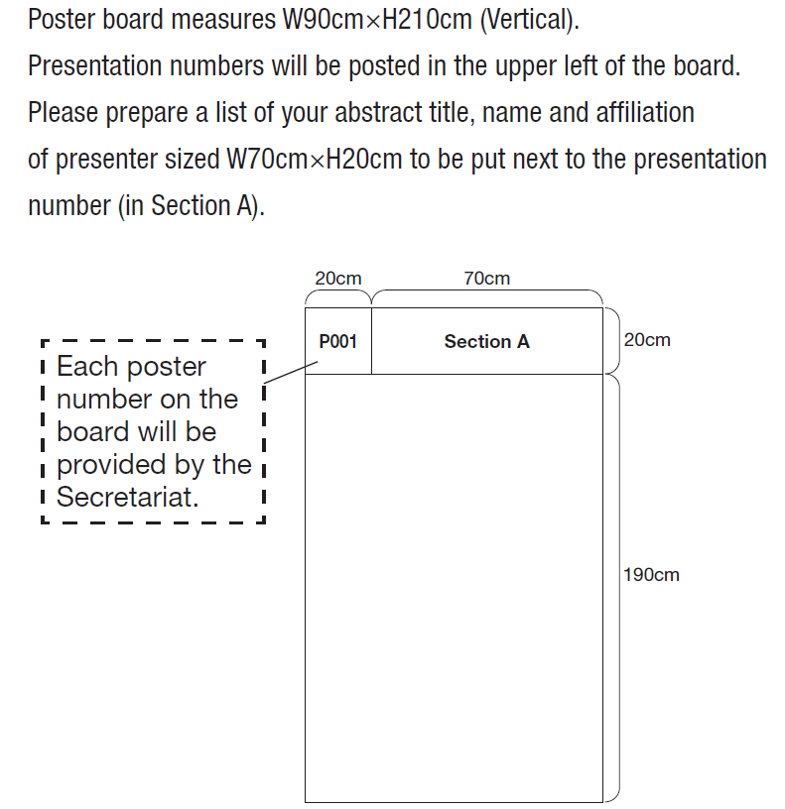
Presentation: 5 minitues
Question & Answer: 3 minitues
Poster Mounting: 17:00-19:00, September 12 / 7:30-13:00, September 13
Poster Removal: 16:00-17:00, September 14
We are pleased to inform you of the acceptance of your submitted abstract as Poster presentation.
The detailed information of your presentation is as below:
---------------------------------------------------
ID Number:90070
Abstract Title:Effect of linagliptin on AVI and API, indices of vascular stiffness evaluated by an automatic blood pressure monitor Presenting Author's Name:Anna Sakashita
Session: Poster 4
Session Theme: Atherosclerosis
Program No.: P25
Order in Session: 06
Time and Date: 13:10-14:10, Saturday, September 13
Venue: Annex Hall, Kyoto International Conference Center
Presentation: 5 minitues
Question & Answer: 3 minitues
Poster Mounting: 17:00-19:00, September 12 / 7:30-13:00, September 13 Poster Removal: 16:00-17:00, September 14

Slide 3
BACKGROUND AND AIMS
Dipeptidyl peptidase 4 inhibitors (DPP4i) have been widely used for the treatment of type 2 diabetic patients. Effect of DPP4i on cardiovascular system is still controversial. Among drugs in this class, linagliptin has been shown to have beneficial effects to reduce incident of cardiovascular events in early preliminary analysis. Pasesa® blood pressure monitor (Shisei Datum, Tokyo, Japan) has received approval for medical use in Japan, this automatic blood pressure monitoring apparatus measures blood pressure, heart rate, and pulse pressure, while simultaneously displaying the condition of central arteries near the heart (AVI) and the stiffness of peripheral blood vessels (API).
In this study, we evaluated AVI and API when type 2 diabetic patients received linagliptin in clinical settings.

Slide 4
METHODS
Medical records of patients visiting to the diabetic clinic at the Saitama Medical Center, Saitama Medical University were analyzed. Linagliptin 5mg q.d. was prescribed by the decision of physicians in charge. The application of this drug and clinical practice is conducted by physicians who practice based on clinical guidelines issued from the Japan Diabetes Society. The prescription of linagliptin was started from April 2013, and we observed the data obtained until June 2014 or any changes of anti-diabetic agents of anti-hypertensive agents or lipid-lowering agents. Pasesa® (AVE-1000, Shisei Datum, Machida, Tokyo, Japan) was used to evaluate AVI and API on each visit. The analysis was approved by the ethical committee of the Saitama Medical Center, Saitama Medical University.

Slide 5
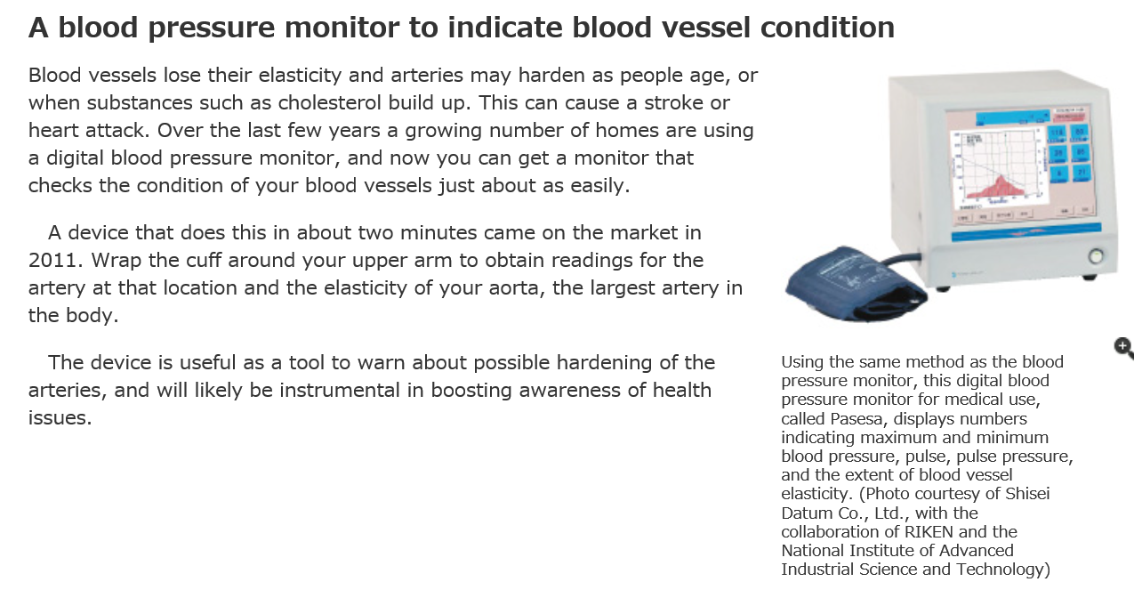

Discovering Japan no.10 page19, 2013

Slide 6
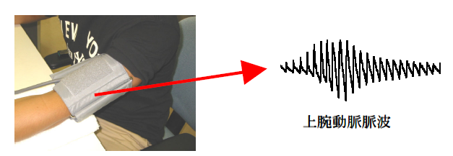
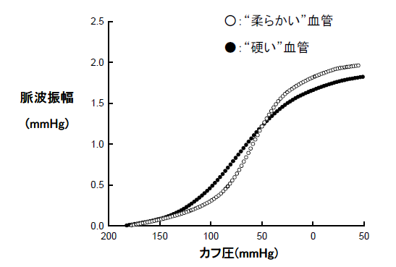
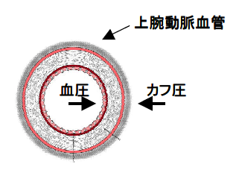
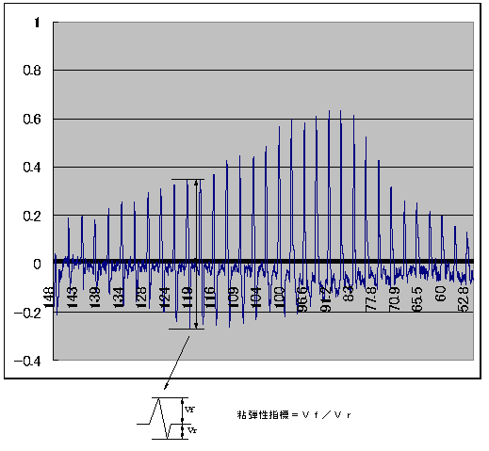
Indices of degree of stiffness of arteries (AVI, API)
Soft vessel
Hard or stiff vessel
Oscillation of the artery
Oscillation
Artery of the upper arm
BP
Cuff pressure
Cuff pressure (mmHg)
Under high cuff pressure, an arterial vessel is suppressed and the volume of the artery becomes smaller. According to the release of the pressure, the volume of the artery which reflects oscillation becomes larger.
AVI： Vr/Vf
Vr: velocity of release, Vf: velocity of fastened
API: α*arctan(β*X+γ)+δ，API＝1／β
X is cuff pressure, and α，β，γ，δ are parameters.

Slide 7
RESULTS
On average, linagliptin was used for 11.9 ± 9.3 months.
Use of anti-diabetic agents: insulin 10 (bolus 15.6, basal 16.1 units/day), glimepiride 1, repaglinide 4, mitiglinide 2, pioglitazone 5, metformin 3.
Use of anti-hypertensive agents: ARB 9, ACEI 1, Ca blocker 7, beta blocker 1, diuretics 2.
Use of lipid-lowering agents: statins 9, fibrate 2, ezetimibe 1.
LDL cholesterol levels are calculated by the Friedewald equation.

Slide 8
SUMMARY
Twenty six diabetic patients (M/F=16/10, age: 68±11y.o., duration of diabetes: 12±11yrs, HbA1c: 7.8±1.4% , BMI: 24±4kg/m², BP: 134±20 / 73±15mmHg) received linagliptin 5mg qd for 11.9 months on average. Although BP at the observation (135±21/70±14mmHg) was not different from the base line, HbA1c was reduced to 7.4±1.6% (p<0.05). AVI (from 23.6±8.4 to 22.6±6.6) and API (from 31.7±8.2 to 33.2±8.9) were not different significantly. While HDL-C was increased from 43±12 to 48±16 mg/dL, LDL-C was not decreased (from 95±21 to 102±31 mg/dL).

Slide 9
CONCLUSIONS
CAROLINA (CARdiovascular Outcome Study of LINAgliptin Versus Glimepiride in Early Type 2 Diabetes) study has been conducted to investigate the long term impact of linagliptin on cardiovascular morbidity and mortality. However the result will not be available until 2018. Our data indicate that there were not any deteriorate effects on AVI, API, and lipid profiles by linagliptin. Since glucose control has been improved it may be possible to expect some beneficial effects by this drug.

Slide 10


The Japan Diabetes Society
COI Disclosure
Anna Sakashita
The author have no financial conflicts of interest to disclose concerning the presentation.

